Slide 1
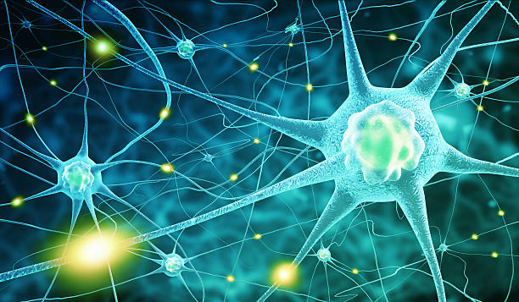

Year 12 Human Biology Mr. Yates Nerve Receptors

Slide 2
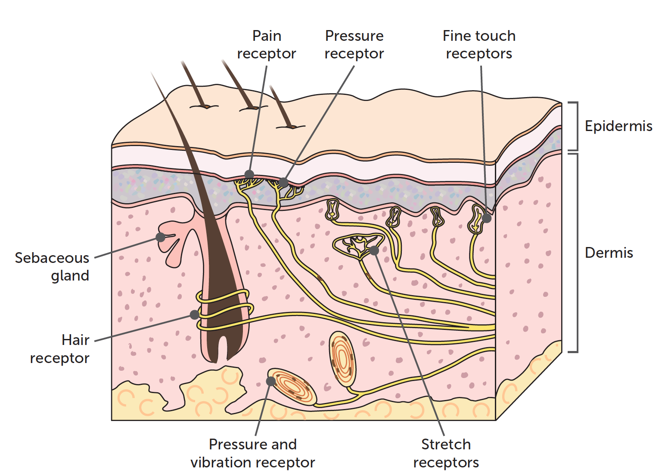
Receptors and Reflexes
A receptor is a structure that is able to detect a change in the body's internal or external environment.
Sometimes receptor cells of a particular type are grouped together in a sense organ, such as the light receptors in the eye or the receptors sensitive to sound vibrations in the ear.
Notes:
Teacher Cue – refer to the vocabulary box as you read through and “unpack” the definition provided. Use hand gestures to emphasise the ”2 or more”, “mixed” and “separated” parts of the definition.
Have students complete CFU 1 as a pair-share, then record these definitions & examples as notes (with diagrams) if desired.
CFU 2 – pair-share, then whiteboards for answers – call on non-volunteers.

Slide 3
Receptors and Reflexes
Other receptors are simple nerve endings and may be spread through parts of the body or even the whole body, such as pain receptors or the temperature receptors in the skin. When a receptor is stimulated, the body is able to respond to the change In some cases, this is via an automatic reflex; in other cases, the response is more complex.

Slide 4
Types of receptors
Changes in the environment may come from different sources. Therefore, there are different types of receptors to be able to detect the different types of stimuli.

Slide 5
Thermoreceptors
Thermoreceptors are able to respond to heat and cold Skin thermoreceptors inform the brain (the hypothalamus and the cerebrum) of changes in the temperature outside the body.
In this way, we are consciously aware of the temperature of our surroundings.

Slide 6
Thermoreceptors
Peripheral thermoreceptors in the skin are nerve endings that are sensitive to either heat or cold, but not both if the skin is tested with bot and cold probes, it is found that there are definite hot spots and cold spots, depending on the type of thermoreceptors present.

Slide 7
Thermoreceptors
The temperature inside the body, the core temperature, is monitored by thermoreceptors in the hypothalamus, which detect the temperature of the blood that is flowing through the brain.
Using information received from the skin and from its own thermoreceptors, the hypothalamus can regulate body temperature.
This process will be discussed further in homeostasis.

Slide 8
Osmoreceptors
Osmotic pressure is determined by the concentration of substances dissolved in the water of the blood plasma. The higher the concentration, the greater the osmotic pressure.
Osmoreceptors are located in the hypothalamus and are sensitive to even very small changes in osmotic pressure.
They can stimulate the hypothalamus so that the body's water content is maintained within very narrow limits.

Slide 9
Chemoreceptors
Chemoreceptors are stimulated by particular chemicals.
They are present in the nose, making us sensitive to odours, and in the mouth, giving us sensitivity to tastes.
There are also internal chemoreceptors that are sensitive to the composition of body fluids.

Slide 10
Chemoreceptors
Of particular importance are chemoreceptors in certain blood vessels that are sensitive to the pH of the blood and to the concentrations of oxygen and carbon dioxide.
These chemoreceptors are involved in the regulation of the heartbeat and of breathing.

Slide 11
Touch Receptors
Touch receptors (also known as mechanoreceptors or pressure receptors) are found mainly in the skin.
There are a number of different types of touch receptors. Some are close to the surface of the skin and are sensitive to very light touch.
These occur in greater concentrations in areas such as the lips, fingertips. eyelids and external genital organs.

Slide 12
Touch Receptors
Nerve endings are also associated with the base of each hair follicle.
These respond to any light touch that bends the hair. Touch receptors close to the skin surface and those attached to the hairs adapt rapidly, and so after a short time we are no longer aware of the touch.
For example, when first putting on clothing we are aware of it touching the skin, but that sensation disappears very quickly. Other touch receptors are located deeper in the skin and are sensitive to pressure and vibrations.

Slide 13
Pain Receptors
Pain receptors (also called nociceptors) are stimulated by damage to the tissues, such as from a cut or a heavy bump, by poor blood flow to a tissue, or by excessive stimulation from stimuli such as heat or chemicals.
The receptors for pain are especially concentrated in the skin and the mucous membranes.

Slide 14
Pain Receptors
They occur in most organs, but not in the brain. Pain is uncomfortable, but it is essential for our wellbeing.
Pain warns us that damage to tissues is occurring, and we can therefore take evasive action or seek medical help so that damage is minimised.

Slide 15
Pain Receptors
Unlike many other receptors, pain receptors adapt little or not at all, so that pain continues for as long as the stimulus is present.
In some cases, prolonged stimulation of pain receptors makes the pain worse.
The failure of pain receptors to adapt keeps the person aware that a tissue-damaging situation exists.

